Slide 1

Where are we?

Slide 2


Slide 3


Slide 4



Slide 5



Slide 6


Slide 7


Slide 9
Where are we?

Slide 10
Position is not absolute

Slide 11
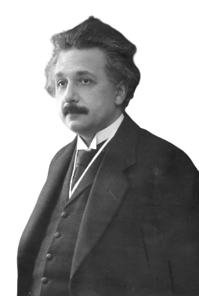
It’s relative

Slide 12
The Theory of Relativity

